Slide 1
Topical treatments for pre-malignant lesions and non-melanoma skin cancer

Slide 2
Aims and objectives
To provide an overview of the current guidelines for management of pre cancerous lesions and non-melanoma skin cancers
Discuss advantages and disadvantages of available treatment modalities
Enable clinician to advise/select appropriate treatment regimen

Slide 3
Skin cancer types
Pre-malignant
Actinic keratosis (AK)
Squamous cell carcinoma in-situ (Bowen’s disease)
Non-melanoma skin cancer
Basal cell carcinoma (BCC)
Squamous cell carcinoma (SCC)
Malignant melanoma
Rare skin tumours
Notes:
Lifted from approved NUR/002/0215, slide 8

Slide 4
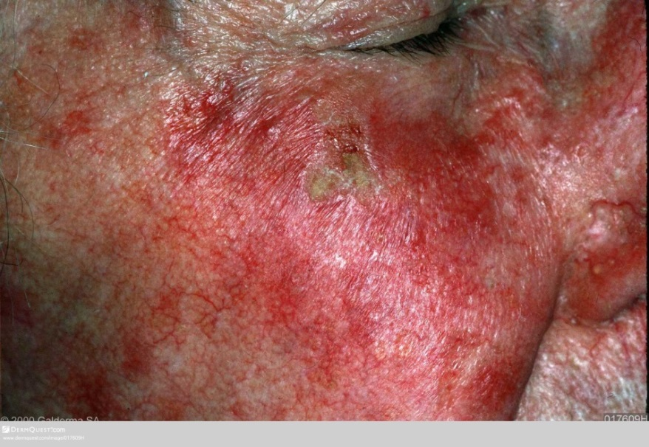
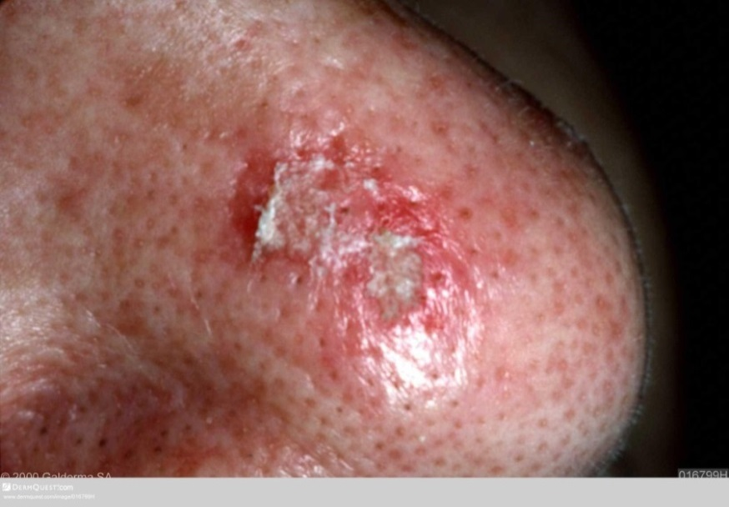
Actinic Keratosis
Notes:
Bottom:
https://www.dermquest.com/image-library/image/5044bfd1c97267166cd66f65
Top left:
https://www.dermquest.com/image-library/image/5044bfd1c97267166cd670a9
Top right:
https://www.dermquest.com/image-library/image/5044bfd1c97267166cd670a4

Slide 5
Aetiology
Focal areas of abnormal keratinocyte proliferation and differentiation, occurring as a result of chronic UV radiation on sun exposed skin
May be restricted to the epithelial basal layer or extend to full thickness atypia at which point lesions are known as SCC in situ, or Bowen’s disease
Carry a low risk of progression to SCC in immune competent individuals
Present as discreet or confluent, single or multiple (field) patches of erythema and scaling and have the potential for spontaneous regression
De Berker D et al; British Association of Dermatologists’ guidelines for the care of patients with actinic keratosis 2017. BJD 2017 Apr;176:20-43
Notes:
Web access:
http://www.bad.org.uk/shared/get-file.ashx?id=4289&itemtype=document
de Berker, D., McGregor, J.M., Mohd Mustapa, M.F., Exton, L.S., Hughes, B.R. (2017) British Association of Dermatologist’s guidelines for the care of patients with actinic keratosis 2017. British Journal of Dermatology (176) pp 20-43

Slide 6
Management
AK is a chronic disease and lesions are part of a spectrum of actinic damage, which is managed rather than cured
Treatment considerations include:
lesion v. field
co-morbidities
risk of progression to invasive SCC
symptoms
cosmetic burden
treatment burden and adherence
treatment efficacy and cost
Provide patient with PIL
De Berker D et al; British Association of Dermatologists’ guidelines for the care of patients with actinic keratosis 2017. BJD 2017 Apr;176:20-43
Notes:
Web access:
http://www.bad.org.uk/shared/get-file.ashx?id=4289&itemtype=document
de Berker, D., McGregor, J.M., Mohd Mustapa, M.F., Exton, L.S., Hughes, B.R. (2017) British Association of Dermatologist’s guidelines for the care of patients with actinic keratosis 2017. British Journal of Dermatology (176) pp 20-43

Slide 7
Treatment options
Monitoring/ no treatment
Assess risk, comorbidities, patient preference
Patient education re lesion changes including pain, bleeding, increase in size or protuberance
An AK European guideline showed preference consensus for cryosurgery for isolated lesions and curettage for larger ones
Otherwise preference revolved largely around common topical agents and variants of PDT.
See PCDS treatment protocol
De Berker D et al; British Association of Dermatologists’ guidelines for the care of patients with actinic keratosis 2017. BJD. 2017 Apr;176:20-43
Notes:
Web access:
http://www.bad.org.uk/shared/get-file.ashx?id=4289&itemtype=document
de Berker, D., McGregor, J.M., Mohd Mustapa, M.F., Exton, L.S., Hughes, B.R. (2017) British Association of Dermatologist’s guidelines for the care of patients with actinic keratosis 2017. British Journal of Dermatology (176) pp 20-43
(1) Werner, R.N., Stockfleth, E.,Connolly, S.M., et al Evidence and consensus based Guidelines for the Treatment of Actinic Keratotis – International league of Dermatological Societies in cooperation with the European Dermatology Forum – short version. J Eur Acad Dermatol Venereol 2015; 29: 2069-79

Slide 8
Common Topical Agents
Diclofenac Sodium 3% gel apply thinly BD for 60-90 days
Fluorouracil 5% (5-FU) cream apply OD/BD for 3-4 weeks, max area 500cm2
Fluorouracil 0.5% & 10% salicylic acid solution OD to lesions for up to 12 weeks
Ingenol mebutate gel 150mcg/g for face and scalp OD for three days and 500mcg for trunk and extremities OD for 2 days
Please consult individual SPC for licensed indications
De Berker D et al; British Association of Dermatologists’ guidelines for the care of patients with actinic keratosis 2017. BJD. 2017 Apr; 176:20-43

Slide 9
Common Topical Agents
Imiquimod 5% cream at night 3 x weekly for 4 weeks, repeat after 4 week treatment gap if necessary
Imiquimod 3.75% once daily for 2 weeks, repeat after two weeks treatment gap
Conventional and Daylight Photodynamic Therapy
See local pre-referral and treatment guidelines
Please consult individual SPC for licensed indications
De Berker D et al; British Association of Dermatologists’ guidelines for the care of patients with actinic keratosis 2017. BJD 2017 Apr; 176:20-43
Notes:
http://www.bad.org.uk/shared/get-file.ashx?id=4289&itemtype=document
P10-13

Slide 10
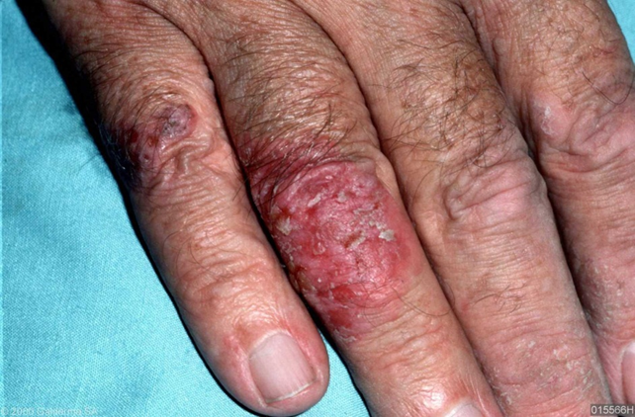
Squamous cell carcinoma in-situ (Bowen’s Disease)
Notes:
Web link to image:
(RI): https://www.dermquest.com/imagelibrary/large/015566HB.JPG

Slide 11
SCC in-situ
Typically well demarcated, erythematous, hyperkeratotic plaque with an irregular border
Characterised by full thickness epidermal dysplasia on histology
Peak incidence in 7th decade, slight female preponderance
Associated with UV exposure (30-50 % of patients have previous or subsequent NMSC), radiotherapy, carcinogens e.g. arsenic, immunosuppression, viral: HPV
Occurs predominately on sun exposed sites, particularly head and neck in men and lower limbs in women
Risk of progression to invasive carcinoma is about 3 -5 %
Morton CA et al: British Association of Dermatologists’ guidelines for the management of squamous cell carcinoma in situ (Bowen’s disease.) BJD.2 014;170:245-260
Notes:
Web link:
BAD guidelines for the management of squamous cell carcinoma in situ (Bowen’s disease) 2014
http://www.bad.org.uk/shared/get-file.ashx?id=1395&itemtype=document

Slide 12
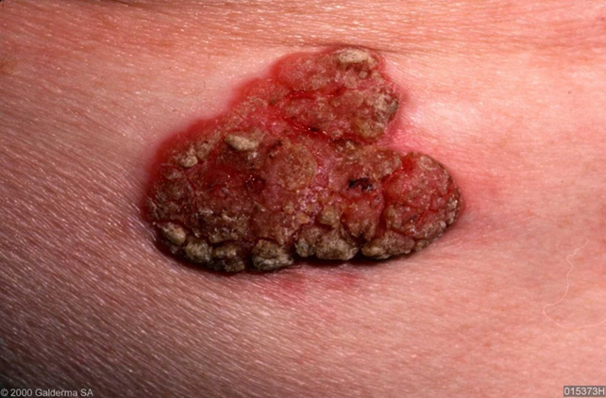
SCC in-situ
Notes:
Lifted from NUR/002/0215, slide 19
Web link to images
(R) https://www.dermquest.com/imagelibrary/large/015373HB.JPG
(L) https://www.dermquest.com/imagelibrary/large/015378HB.JPG

Slide 13
Treatments for SCC in-situ
Provide patient with PIL
Considerations include lesion size, thickness and site (potential for healing)
No treatment/surveillance
e.g. in elderly patients with slowly progressing thin lesions on lower leg
Use of an urea based emollient can reduce scaling and render less obvious
Please consult individual SPC for licensed indications
Morton CA et al: British Association of Dermatologists’ guidelines for the management of squamous cell carcinoma in situ (Bowen’s disease.) BJD 2014; 170:245-260
Notes:
Web link:
BAD guidelines for the management of squamous cell carcinoma in situ (Bowen’s disease) 2014
http://www.bad.org.uk/shared/get-file.ashx?id=1395&itemtype=document
pp 248

Slide 14
Treatments
Topicals
5-Fluorouracil (5-FU) OD/BD 3-4 weeks, repeat if required. Cytotoxic action destroys cancerous and pre-cancerous cells
Imiquimod 5% (unlicensed) 5 times per week for 6 weeks. Acts by stimulating immune response. Has potential to stimulate pre-existing autoimmune disease
Please consult individual SPC for licensed indications
www.dermnetnz.org/topics/intraepidermal-carcinoma/ Accessed 06.11.17
Notes:
Web link:
https://www.dermnetnz.org/topics/intraepidermal-carcinoma/

Slide 15
Treatments
Cryotherapy Regimens vary, higher clearance success rates with the more aggressive single freeze thaw cycle (FTC) of 30 seconds, or 20 seconds twice, compared to a single 20 second FTC. Risk of ulceration, more suitable for small single lesions on areas with good healing
Curette and cautery One of most simple, effective and better tolerated options
PDT Superior cosmetic results compared to cryotherapy and topical therapy and particularly suitable for lesions that are large, single, and sites of poor healing
Please consult individual SPC for licensed indications
Morton CA et al: British Association of Dermatologists’ guidelines for the management of squamous cell carcinoma in situ (Bowen’s disease.) BJD. 2014; 170:245-260
Notes:
Web link:
BAD guidelines for the management of squamous cell carcinoma in situ (Bowen’s disease) 2014
http://www.bad.org.uk/shared/get-file.ashx?id=1395&itemtype=document

Slide 16
Treatments
Excision Consider cosmetic outcome, size and site of lesion with regard to vascularity and healing potential
Mohs micrographic surgery Tissue sparing benefits considered for digital and genital lesions, and recurrent or incompletely excised lesions
Radiotherapy Poor healing outcomes on lower leg lesions. Effective where other treatments have failed or are unsuitable e.g. scalp
Laser Limited study data
Please consult individual SPC for licensed indications
Morton CA et al; British Association of Dermatologists’ guidelines for the management of squamous cell carcinoma in situ (Bowen’s disease.)BJD. 2014;170:245-260
Notes:
Web link:
BAD guidelines for the management of squamous cell carcinoma in situ (Bowen’s disease) 2014
http://www.bad.org.uk/shared/get-file.ashx?id=1395&itemtype=document

Slide 17
Basal Cell Carcinoma (BCC)
Locally invasive malignant epidermal skin tumour predominantly affecting Caucasians
The most common cancer in Europe, Australia and the USA. Continued rise in tumour incidence in UK predicted up to 2040 relating to increasingly elderly population
Aetiological factors include genetic predisposition and UV exposure
Metastasis is extremely rare
Morbidity results from local tissue invasion and destruction particularly on the face, head and neck
Telfer NR et al; Guidelines for the management of basal cell carcinoma. BJD. 2008 Mar;159,35-48
Notes:
Web link:
http://www.bad.org.uk/shared/get-file.ashx?id=45&itemtype=document
Guidelines for the management of basal cell carcinoma.
N.R.Telfer, G.B. Colver and C.A. Morton (2008) British Journal of Dermatology 159 pp35-48

Slide 18
Basal cell carcinoma (BCC)
Clinical sub-types
Nodular (nBCC)
Superficial (sBCC)
Morphoeic
Pigmented
Histological subtypes
Adenocystic (glandular differentiation)
Microcystic (milia formation)
Micronodular (often deeply infiltrating)
Neurotropic
Basosquamous (includes features of squamous cell carcinoma)
Telfer NR et al; Guidelines for the management of basal cell carcinoma. BJD. 2008 Mar;159,35-48
Notes:
https://www.dermnetnz.org/cme/lesions/basal-cell-carcinoma-cme/

Slide 19
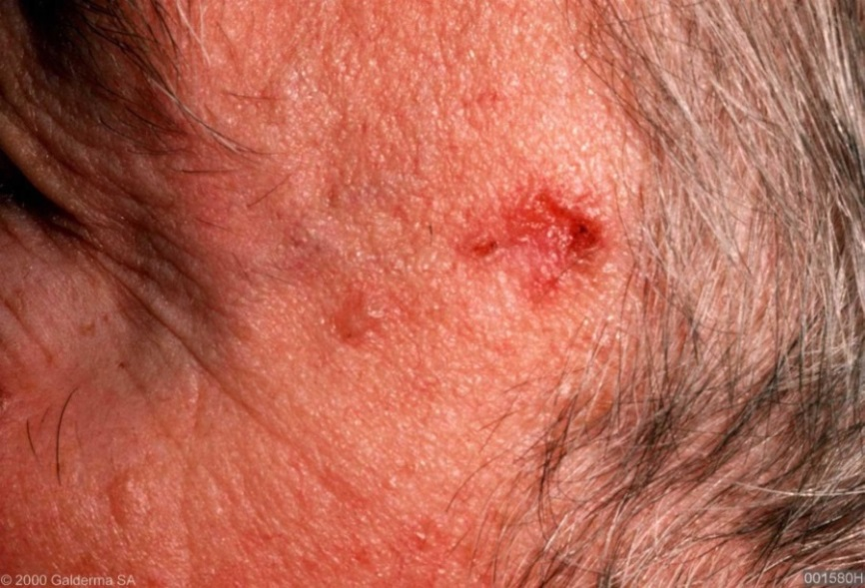
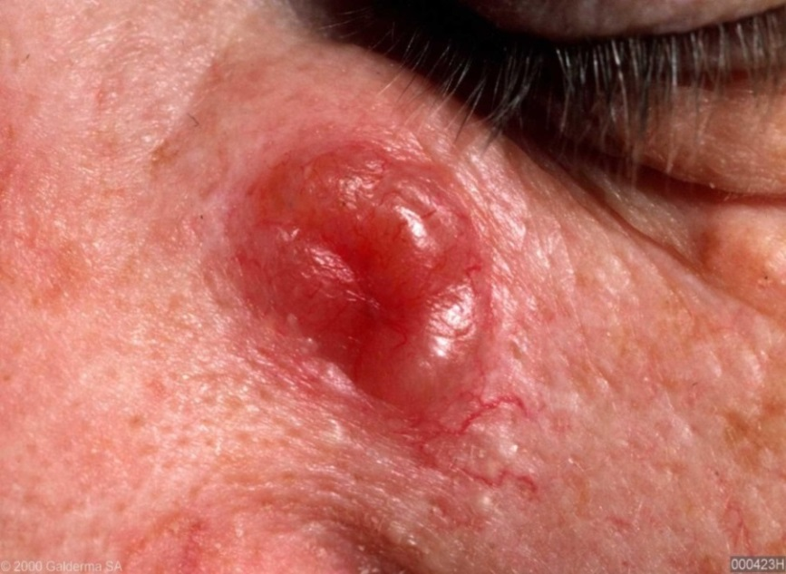
Nodular BCC (nBCC)
Notes:
Lifted from NUR/002/0215, slide 27
Web link to image:
(UL): https://www.dermquest.com/image-library/image/5044bfd1c97267166cd66df4
(R): https://www.dermquest.com/imagelibrary/large/002306HB.JPG
(LL) image: https://www.dermquest.com/imagelibrary/large/000423HB.JPG

Slide 20
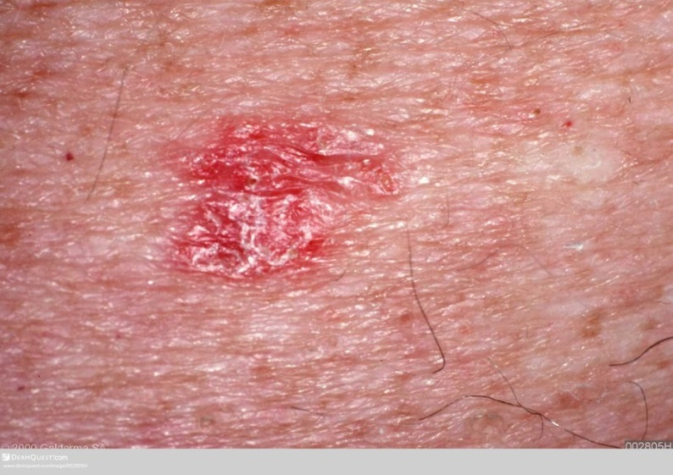
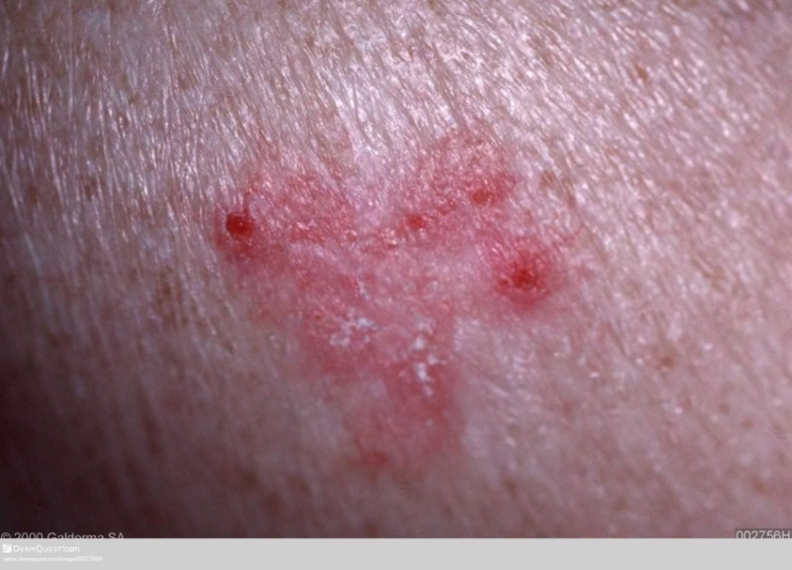
Superficial BCC (sBCC)
Notes:
(UL) https://www.dermquest.com/image-library/image/5044bfd1c97267166cd66e1d
(right) https://www.dermquest.com/image-library/image/5044bfd1c97267166cd66fd0
(LL) https://www.dermquest.com/image-library/image/5044bfd1c97267166cd66e1b

Slide 21
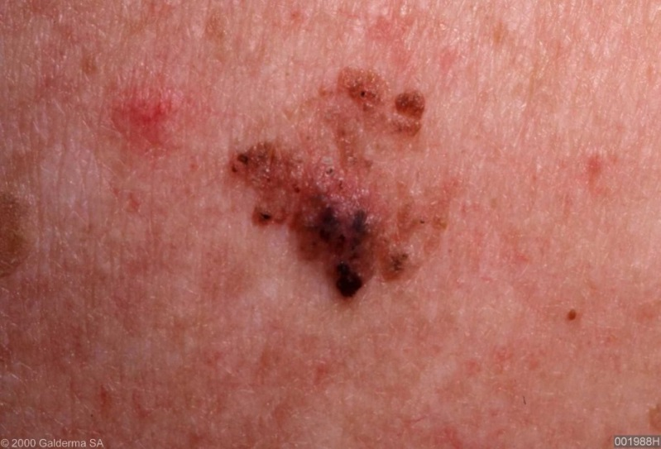
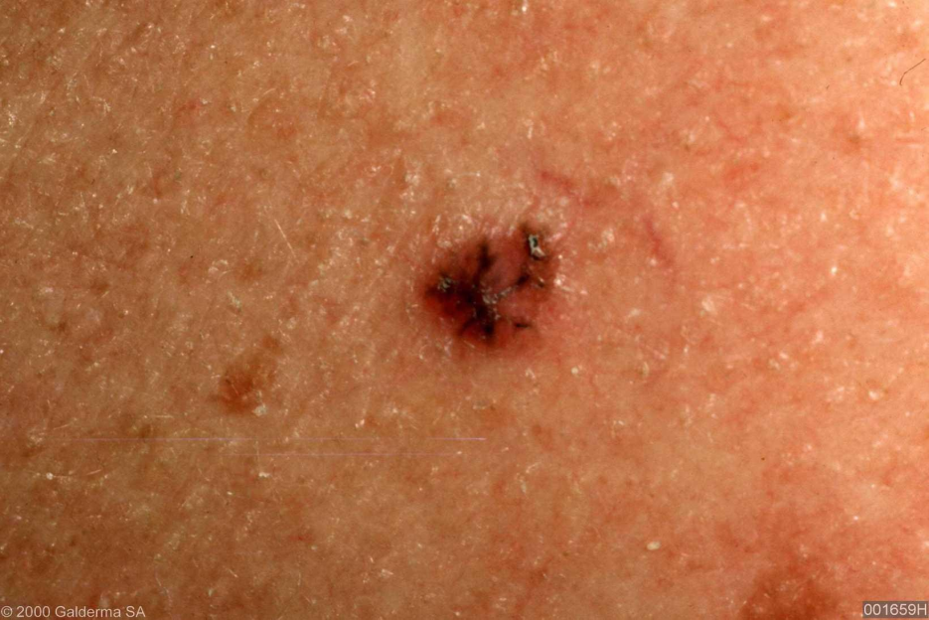
Pigmented BCC
Notes:
Lifted from NUR/002/0215, slide 32
Web link to images:
(TL): https://www.dermquest.com/imagelibrary/large/001988HB.JPG
(R): https://www.dermquest.com/imagelibrary/large/003348HB.JPG
(LL): https://www.dermquest.com/imagelibrary/large/001659HB.JPG

Slide 22
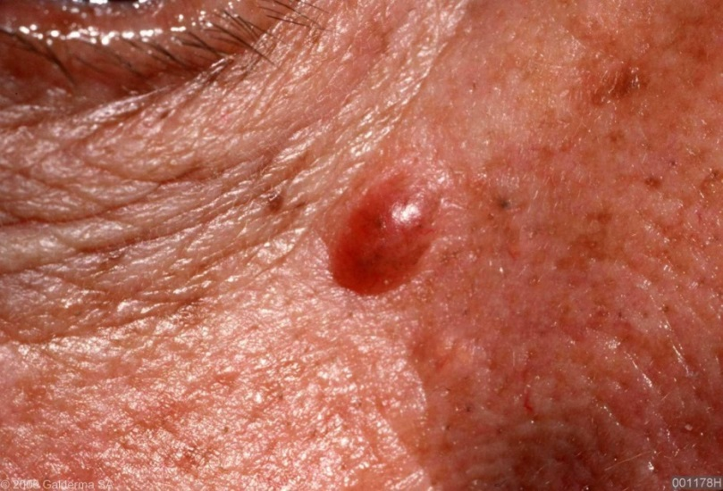
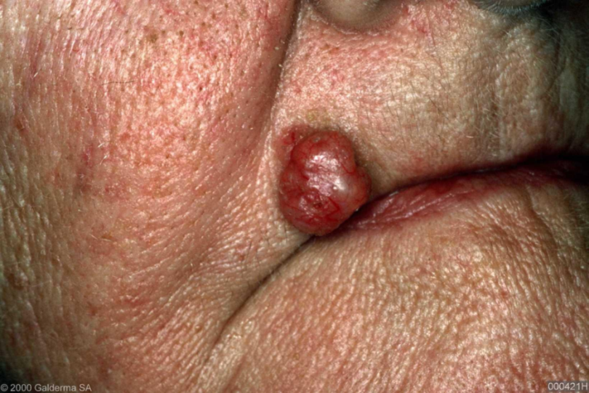
Cystic BCC
Notes:
Lifted from NUR/002/0215, slide 31
Web link to images;
(TL): https://www.dermquest.com/imagelibrary/large/001178HB.JPG
(R): https://www.dermquest.com/imagelibrary/large/003294VB.JPG
(LL): https://www.dermquest.com/imagelibrary/large/000421HB.JPG

Slide 23
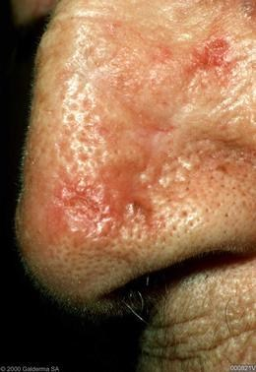
Morphoeic or Atrophic BCC
Notes:
Lifted from NUR/002/0215, slide 33
Web link to images:
(L): https://www.dermquest.com/imagelibrary/large/000821VB.JPG
(R): https://www.dermquest.com/imagelibrary/large/002461HB.JPG

Slide 24
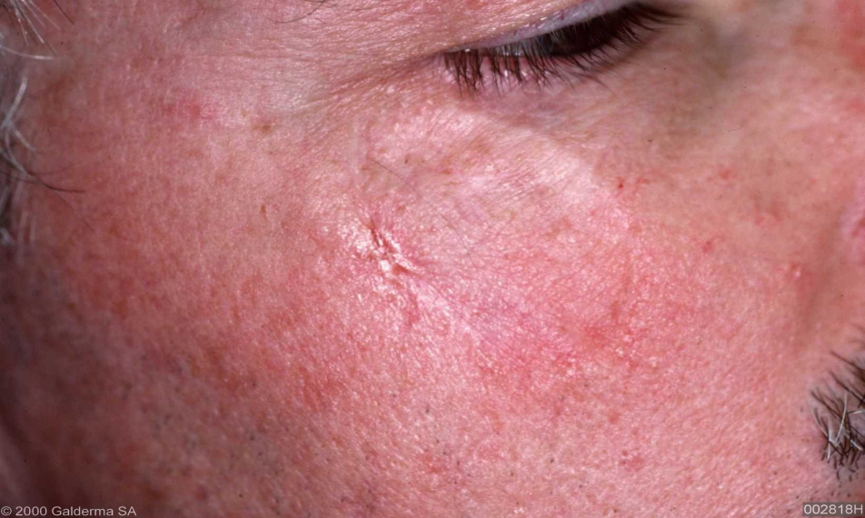
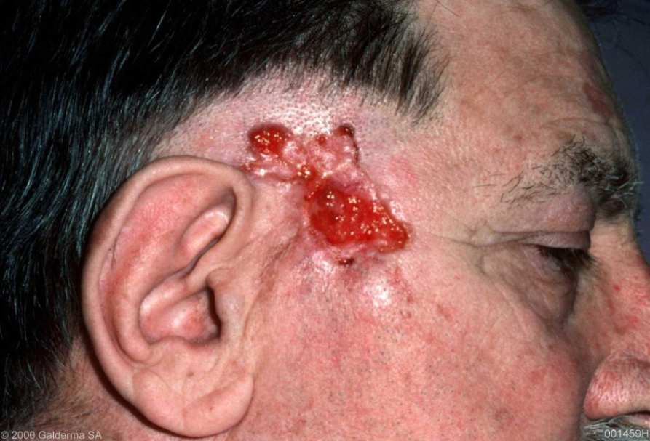
Recurrent BCC
Notes:
Lifted from NUR/002/0215, slide 35
Web link to images:
(TL): https://www.dermquest.com/imagelibrary/large/002386HB.JPG
(TR): https://www.dermquest.com/imagelibrary/large/001459HB.JPG
(LL): https://www.dermquest.com/imagelibrary/large/002818HB.JPG
(LR): https://www.dermquest.com/imagelibrary/large/001768HB.JPG

Slide 25
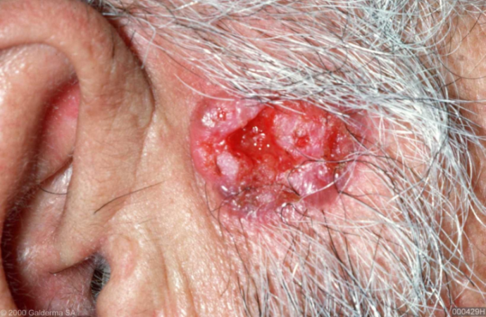
Ulcerated BCC
Notes:
Lifted from NUR/002/0215, slide 34
Web link to images:
(R): : https://www.dermquest.com/imagelibrary/large/000430VB.JPG
(L): https://www.dermquest.com/imagelibrary/large/000429HB.JPG

Slide 26
Management
Treatment selection and prognostic advice given to patient is based on assessment of lesion as being either LOW or HIGH RISK (of recurrence)
Treatment choice considerations also include general fitness, coexisting medical conditions, use of anticoagulation/antiplatelet medication, patient choice, local availability of specialised services, cosmetic outcome
Telfer NR et al; Guidelines for the management of basal cell carcinoma. BJD. 2008 Mar; 159:35-48
Notes:
Web link:
http://www.bad.org.uk/shared/get-file.ashx?id=45&itemtype=document
Guidelines for the management of basal cell carcinoma.
N.R.Telfer, G.B. Colver and C.A. Morton (2008) British Journal of Dermatology 159 pp35-48

Slide 27
Factors for higher risk of recurrence
Tumour size: larger
Tumour site: lesions on central face especially around eyes, lips, nose, ears
Clinical margins: poorly defined lesions
Histological subtype: certain subtypes eg morphoeic
Histological features of aggression: perineural/perivascular involvement
Failure of previous treatment: recurrent lesions
Immunosuppression
Telfer NR et al; Guidelines for the management of basal cell carcinoma. BJD. 2008 Mar;159:35-48
Notes:
Web link:
http://www.bad.org.uk/shared/get-file.ashx?id=45&itemtype=document
Guidelines for the management of basal cell carcinoma.
N.R.Telfer, G.B. Colver and C.A. Morton (2008) British Journal of Dermatology 159 pp35-48

Slide 28
Surgical treatments
Surgery and radiotherapy remain treatment of choice for majority of high risk lesions
Surgery has the lowest overall failure rate in the treatment of both low and high risk BCCs (less than 2% recurrence at 5 years)
Curettage and cautery (C&C) and Cryosurgery are considered appropriate for treatment of low risk lesions e.g. small nodular or superficial BCCs
Please consult individual SPC for licensed indications
Telfer NR et al; Guidelines for the management of basal cell carcinoma. BJD. 2008 Mar; 159:35-48
Notes:
Web link:
http://www.bad.org.uk/shared/get-file.ashx?id=45&itemtype=document
Guidelines for the management of basal cell carcinoma.
N.R.Telfer, G.B. Colver and C.A. Morton (2008) British Journal of Dermatology 159 pp35-48

Slide 29
Non-surgical treatments
5% Imiquimod cream: small Superficial BCCs, OD 5 times per week for 6 weeks
Photodynamic therapy (PDT): Superficial BCCs and low risk Nodular BCCs. Good cosmetic outcomes. Option for BCCs when other more effective treatments are contraindicated or unacceptable to patients
Radiotherapy: primary BCC, recurrent BCC, as adjuvant therapy, high risk lesions in patients who are unwilling or unable to tolerate surgery
Vismodegib 150mgs (17): symptomatic metastatic basal cell carcinoma and locally advanced basal cell carcinoma inappropriate for surgery or radiotherapy
Please consult individual SPC for licensed indications
Telfer NR et al; Guidelines for the management of basal cell carcinoma. BJD. 2008 Mar; 159:35-48
www.medicines.org.uk/emc/medicine/28107 Accessed 06.11.17
Notes:
Web link:
(16) http://www.bad.org.uk/shared/get-file.ashx?id=45&itemtype=document
Guidelines for the management of basal cell carcinoma.
N.R.Telfer, G.B. Colver and C.A. Morton (2008) British Journal of Dermatology 159 pp35-48
(17) http://www.medicines.org.uk/emc/medicine/28107/SPC/

Slide 30
In conclusion
There are many evidence based treatment modalities for patients with pre cancerous and NMSC
It is important that the most appropriate treatment is considered and tailored made for each individual patient

