Slide 1

DIABETES AND THE HEART
This meeting has been fully organised and funded by MSD
Prescribing and Adverse Event Reporting information can be found on the final slide
Please refer to relevant product SPC for full prescribing information
The views of the speaker are their own and may not represent he opinions of MSD
Dr Somnath Kumar - Consultant Cardiologist Lancashire Teaching Hospital
DIAB-1245268-0000
Date of Preparation Jan 2018 Merck Sharp & Dohme Limited. Registered office: Hertford Road, Hoddesdon, Hertfordshire, EN11 9BU
d

Slide 2
PEARLS FOR YOUR
PRACTICE

Slide 3
Disclosures related to this talk
MSD- honoraria

Slide 4

WHAT HAS THIS MAN GOT TO DO WITH
Today ?

Slide 5
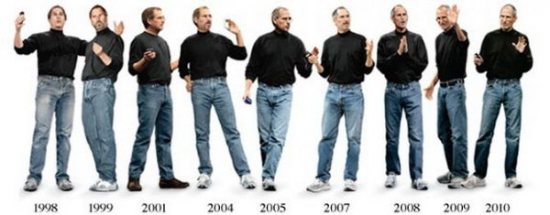

Slide 6

CHOICE

Slide 7

IMPACT
700 per day
5 million by 2025
£10 billion spent by NHS on diabetes –
…………..80% due to complications

Slide 8

Before we begin
HOW PRACTICE NURSES HAVE WRITTEN THEIR OWN HISTORY

Slide 9
75 000 REGISTERED NURSES OVER 22 YEARS
3 NIGHTS PER MONTH AND USUAL DAY TIME
< 14 YEARS……..19% RISK OF DEATH
>15 YEARS….23% RISK OF DEATH AND 25% INCREASE IN LUNG CANCER

Slide 10
Type 2 diabetes and the heart : scope of presentation
Why is it important ?
Why does the heart get affected ?
Is it just the sugar ?
How can we control the diabetes to reduce heart disease ? AND make people live longer ?

Slide 11
Diabetes Is Associated With Increased Risk of CV Disease
increased risk for MI, stroke, and PAD^{1–3}
It is not clear whether diabetes should be considered a cause or a comorbidity of heart failure⁴
Diabetes is associated with a 2- to 3-fold increase in the risk of CV and all-cause mortality⁵
CV = cardiovascular; MI = myocardial infarction; PAD = peripheral artery disease; CHD = coronary heart disease; HF = heart failure.
1. Emerging Risk Factors Collaboration. Lancet. 2010;375:2251–2222. 2. American Diabetes Association. Diabetes Care. 2003;26:3333–3341. 3. American Diabetes Association. Diabetes Care. 2014;37:S14–S80. 4. McMurray JJV et al. Lancet Diabetes Endocrinol. 2014; DOI 10.1016/S2213-8587(14)70031-2. 5. Gregg EW et al. Ann Int Med. 2007;147:149–156.
Notes:
Diabetes Is Associated With Increased Risk of CV Disease
Patients with diabetes are at increased risk for stroke, myocardial infarction (MI), and peripheral artery disease (PAD).^{1–3}
Individuals with diabetes have an increased prevalence of heart failure vs those without diabetes. Diabetes is believed to promote the development of myocardial fibrosis and diastolic dysfunction, and is also associated with increased risk of developing heart failure in patients with underlying cardiovascular (CV) comorbidities (eg, previous acute MI).⁴
Diabetes is associated with a 2- to 3-fold increase in the risk of CV and all-cause mortality.⁵
Purpose
To illustrate the elevated prevalence of morbidity and mortality associated with CV disease among patients with diabetes.
Takeaway
Diabetes confers an increased risk for MI, stroke, PAD, and death from CV causes.
1. Emerging Risk Factors Collaboration. Lancet. 2010;375:2251–2222. 2. American Diabetes Association. Diabetes Care. 2003;26:3333–3341. 3. American Diabetes Association. Diabetes Care. 2014;37:S14–S80. 4. McMurray JJV et al. Lancet Diabetes Endocrinol. 2014; DOI 10.1016/S2213-8587(14)70031-2. 5. Gregg EW et al. Ann Int Med. 2007;147:149–156.

Slide 12
Diabetes is associated with significant loss of life years
Men
Women
7
6
5
4
3
2
1
0
Non-vascular deaths
Vascular deaths
7
6
5
4
3
2
1
0
Years of life lost
0
40
50
60
70
80
90
0
40
50
60
70
80
90
Age (years)
Age (years)
On average, a 50-year-old individual with diabetes and no history of vascular disease will die 6 years earlier compared to someone without diabetes
.

Slide 13
Hyperglycaemia results from three core defects^{1,2}
1. Peripheral tissue
Decreased glucose uptake
2. Liver
Hepatic glucose over-production
3. Pancreas
beta cells alpha cells
Decreased Excessive
insulin secretion glucagon secretion
Hyperglycaemia
1. Inzucchi SE. JAMA 2002;287:360–372.
2. Porte D Jr, Kahn SE. Clin Invest Med 1995;18:247-254.

Slide 14
INSULIN RESISTANCE

Slide 15
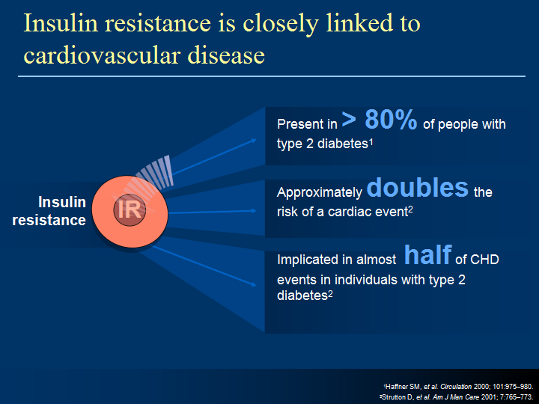

Slide 16
Development and Progression of
Type 2 Diabetes and Related Complicationsª
Progression of Type 2 Diabetes Mellitus
Insulin resistance
Hepatic glucose production
Insulin level
Beta-cell function
4–7 years
Postprandial
glucose
Fasting plasma glucose
Development of Microvascular Complications
Development of Macrovascular Complications
Impaired Glucose Tolerance
Frank Diabetes
Diabetes Diagnosis
Reprinted from Primary Care, 26, Ramlo-Halsted BA, Edelman SV, The natural history of type 2 diabetes. Implications for clinical practice, 771–789, © 1999, with permission from Elsevier.
ªConceptual representation.
JAN/32017-11
Notes:
Development and Progression of Type 2 Diabetes
This slide demonstrates VIEW THIS IS SLIDE SHOW TO SEE ALL THE TRAJECTORIES
– in the initial stages it is insulin resistance , later that flattens
50% beta cell destruction is present at onset. Later it is the beta cell dysfunction that matters along with
Hepatic glucose production
Insulin levels decrease over time
NB – Microvascular complications occure later than macrovascular damage
This conceptual diagram shows a proposed paradigm on the development and progression of pathophysiology in type 2 diabetes.¹
The horizontal axis in the figure shows the years before and after diagnosis of diabetes.
Insulin resistance begins years before diagnosis.¹ Insulin resistance rises during disease development and continues to rise during impaired glucose tolerance (IGT). Over time, insulin resistance remains stable during the progression of type 2 diabetes.¹
The insulin secretion rate increases to compensate for the decrease in insulin effectiveness due to insulin resistance. β-cell function can decrease even as insulin secretion increases. At the time of diagnosis of type 2 diabetes and 6 years afterwards about 50% and 73% of β-cell function has been lost, respectively.² Over time, β-cell compensatory function deteriorates and insulin secretion decreases. β-cell function progressively fails.^{1,2}
Initially, fasting glucose is maintained in near-normal ranges. The pancreatic β cells compensate by increasing insulin levels, leading to hyperinsulinemia. This compensation keeps glucose levels normalized for a time, but as β cells begin to fail, IGT develops with mild postprandial hyperglycemia. As the disease progresses, the β cells continue to fail, resulting in higher PPG levels. With continued loss of insulin secretory capacity, fasting glucose and hepatic glucose production increase.¹
Once β cells cannot secrete sufficient insulin to maintain normal glycemia at the fasting or postprandial stage, type 2 diabetes (hyperglycemia) becomes evident.
Insulin resistance and β-cell dysfunction are established well before type 2 diabetes is diagnosed.¹
References
Ramlo-Halsted BA, Edelman SV. The natural history of type 2 diabetes. Implications for clinical practice. Prim Care. 1999;26:771–789.
Bell DSH. The case for combination therapy as first-line treatment for type 2 diabetic patients. Treat Endocrinol. 2006;5:131–137.
Purpose
To address the common misconception that an increase in insulin secretion (hyperinsulinemia) connotes an improvement in β-cell function.
Takeaway
Both insulin resistance and β-cell dysfunction start early–and well before diabetes is diagnosed–leading to rises in fasting plasma glucose (FPG) and postprandial glucose (PPG) levels.

Slide 18
DIABETIC COMPLICATIONS
MICRO-VASCULAR
MACROVASULAR

Slide 20
Diabetes and heart disease
Increased coronary disease ( x 3 )
More severe disease at presentation
Atypical presentation
Increased heart failure ( x 2.5 )
Abnormal lipid metabolism
Loss of pre menopausal protection
Sudden cardiac death

Slide 21
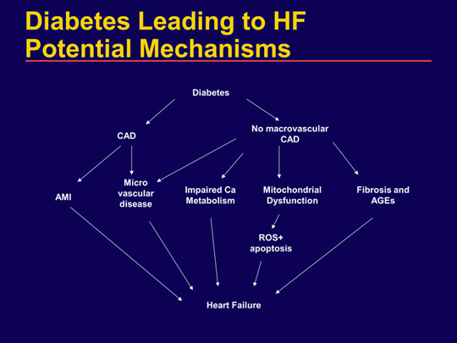

Slide 23
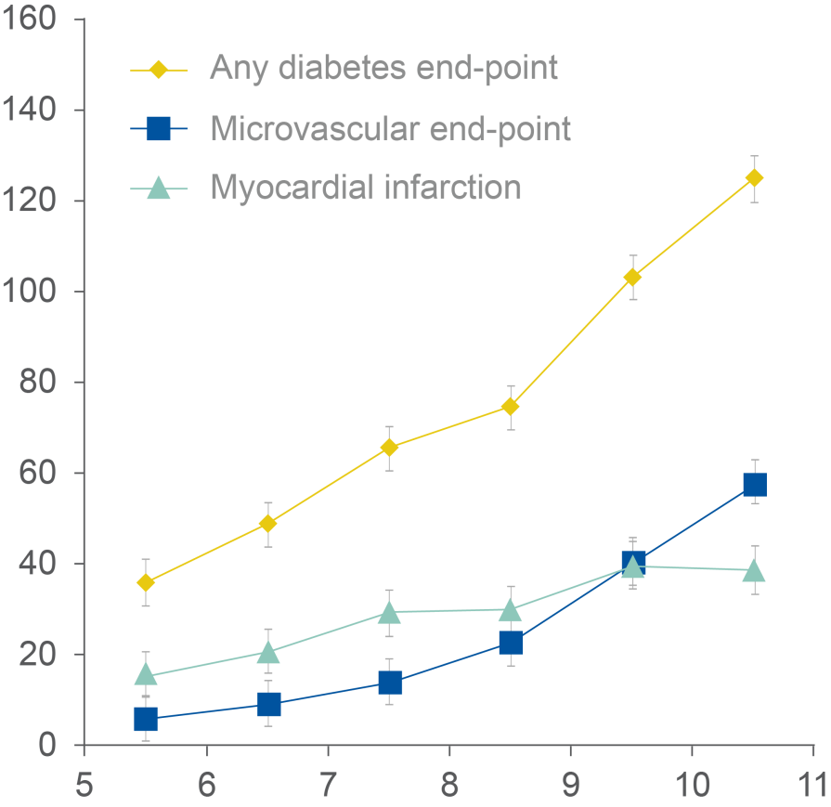
UKPDS: Improving HbA_{1c} control reduces diabetes-related complications¹
Incidence of complications
n=4,585
Relative risk
n=3,642
Every 1%
reduction in HbA_{1c}
Reduced risk (p<0.0001)
Diabetes-
related
deaths
21%
Myocardial infarction
14%
Adjusted incidence
per 1,000 person years (%)
1%
(11 mmol/mol)
Microvascular complications
37%
Amputations or deaths from peripheral vascular disease
43%
Mean HbA_{1c} (%)
Observational analysis of relation between glycaemic exposure and complications of diabetes as estimated by decrease in risk for 1% reduction in HBA_{1c}, measured at baseline and as updated mean. Data adjusted for age at diagnosis of diabetes, sex, ethnic group, smoking, presence of albuminuria, systolic blood pressure, high and low density lipoprotein cholesterol, and triglycerides.
Adapted from Stratton IM et al.
Data adjusted for age, sex, and ethnic group, expressed for white men aged 50–54 years at diagnosis and with mean duration of diabetes of 10 years.
Stratton IM et al. BMJ 2000;321:405–412.

Slide 24
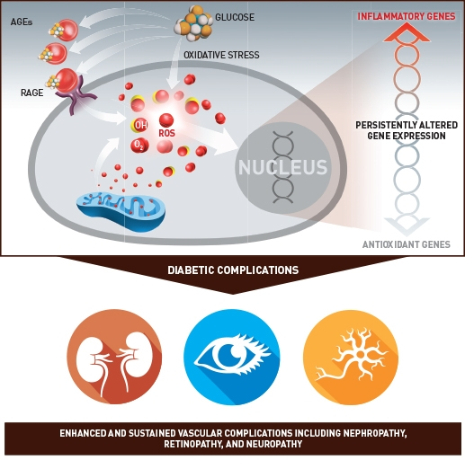
MOTHER NATURE KEEPS A SCORE

Slide 25
Big Picture Messages early stages of diabetes
Type 1 and type 2 diabetes: early meticulous glucose control can prevent microvascular and neuropathic complications
Type 1 and type 2 diabetes: early meticulous glucose control appears to prevent CVD many years later (“metabolic memory” and “legacy effect”)

Slide 26
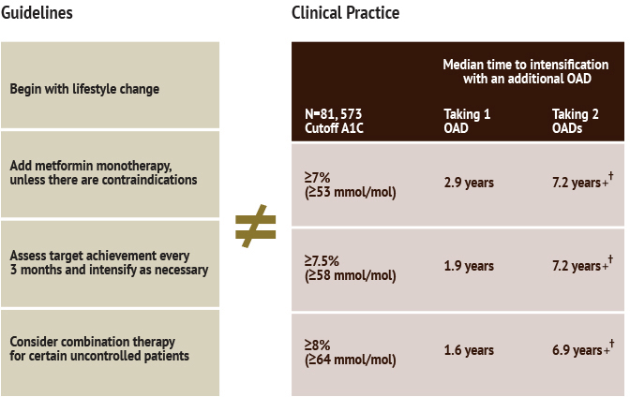

Slide 27
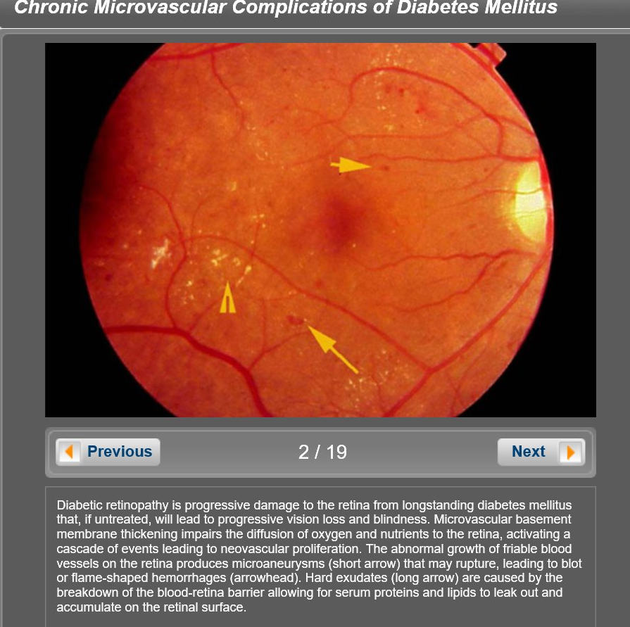
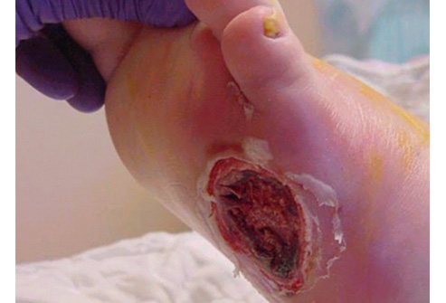

Slide 28
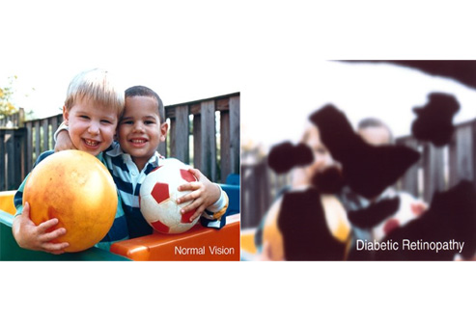

Slide 29
More Big Picture Messages
Type 2 diabetes:
patients with known CVD or
long duration of diabetes
may be harmed
by meticulous control (hypoglycemia)

Slide 30

So, What Are the A1C Targets?

Slide 31
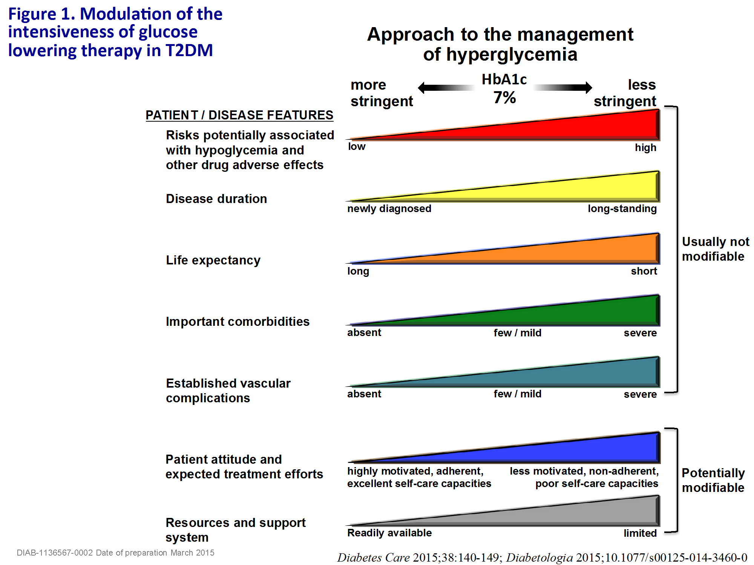

Slide 32
Still More Big Picture Messages
Long duration diabetes
Type 1 diabetes: impact of glycemia on microvascular disease not present after 20-25 years (probably true for type 2 diabetes, too)
At that stage it appears that blood pressure and LDL cholesterol levels better predict CVD mortality than A1C

Slide 33
Forms the basis for degree of
aggressiveness with lipid Rx

Slide 34
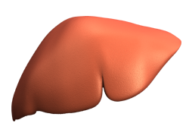
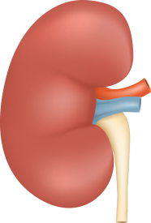
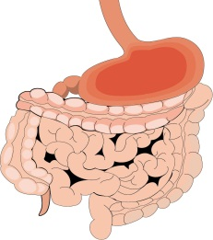
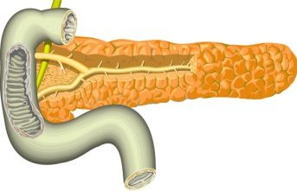
Target sites for different oral drug classes used in type 2 diabetes¹⁻³
Liver
Decrease glucose production
Metformin
(Pioglitazone)
Inhibition of glucose reabsorption in the kidney
SGLT2 inhibitors
(e.g. dapagliflozin)
Ways to reduce
hyperglycaemia
Gut
Kidney
Pancreatic beta cells
Enhancing levels of active incretin hormones
Dipeptidyl peptidase 4 (DPP-4) inhibitors (e.g. sitagliptin)
Increase insulin secretion
Sulphonylureas (e.g. glimepiride)
Non-SU secretagogues
(e.g. repaglinide, nateglinide)
Muscle and adipose tissue
1. Inzucchi SE. JAMA 2002;287:360–372.
2. Januvia (sitagliptin) SPC
3. Dapagliflozin SPC (April 2016)
4. Pioglitazone SPC (May 2016)
5. Repaglinide SPC (May 2016)
6. Nateglinide SPC (June 2015)
7. Metformin SPC (January 2015)
Increase glucose uptake
Pioglitazone)
SGLT2=sodium–glucose co-transporter 2; SPC=Summary of Product Characteristics; SU=sulphonylurea; TZDs=thiazolidinediones

Slide 35
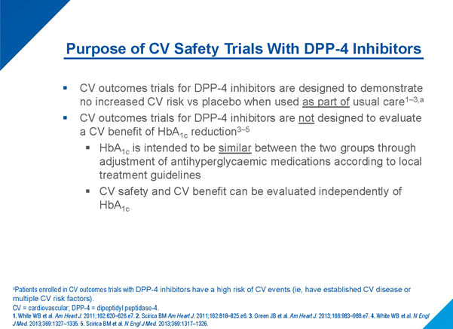

Slide 36
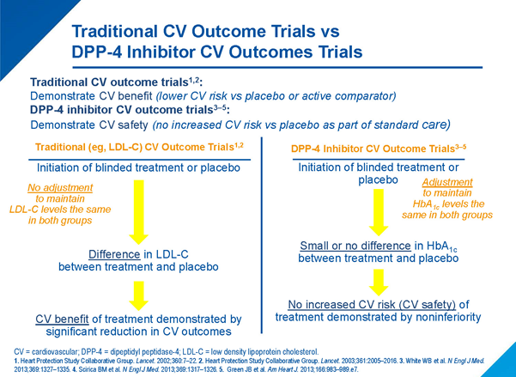

Slide 37
Most DPP4 inhibitors are currently studied in large CV outcome trials
Clinical trials cannot be directly compared as they are conducted in different patient populations
TECOS¹
SAVOR-TIMI 53²
EXAMINE³
CARMELINA⁴
CAROLINA⁵
DPP4 inhibitor
Sitagliptin
Saxagliptin
Alogliptin
Linagliptin
Linagliptin
Comparator
Placebo
Placebo
Placebo
Placebo
SU (active)
No. of patients
14,671
16,492
5,380
8,300
6,000
Trial completion
Mar 2015
May 2013
Jun 2013
est. Jan 2018
est. Mar 2019
Background
diabetes therapy
per protocol
Any
Any
Any
Any
Predominantly on metformin
background
Median duration
of follow up
3.0
2.1
1.5
Key inclusion criteria
Pre-existing
CV disease
High risk for
CV events
History
of ACS
Previous vascular complications and albuminuria; evidence of renal-related
end-organ damage
Previous vascular complications; evidence of end-organ damage;
≥ 2 specified traditional CV risk factors
1,4,5. Primary endpoint: CV death, non-fatal MI, non-fatal stroke, hospitalisation due to unstable angina pectoris.
2, 3. Primary endpoint: major adverse CV events (CV death, non-fatal MI, non-fatal stroke).
www.ClinicalTrials.gov.
Notes:
Approval date: 200215

Slide 38
EXAMINE and SAVOR-TIMI:
Hospitalisation for Heart Failure
EXAMINE^{1,2}
  EXAMINE: In a post-hoc analysis, there was a trend (P=NS) for increased hospitalisation for HF with alogliptin compared with placebo²
 | Alogliptin n=2,701 | Placebo n=2,679 | HR (95% CI)
HHFª | 3.9% | 3.3% | 1.19 (0.89–1.58)
  SAVOR-TIMI: Hospitalisation for HF was significantly increased with saxagliptin compared with placebo³
  Mortality due to HF was not significantly different between saxagliptin and placebo (0.5% for both)³
SAVOR-TIMI³
 | Saxagliptin n=8,280 | Placebo n=8,212 | HR (95% CI)
HHF | 3.5% | 2.8% | 1.27 (1.07–1.51)
ªPost-hoc analysis.
EXAMINE = Examination of Cardiovascular Outcomes: Alogliptin vs Standard of Care in Patients With Type 2 Diabetes Mellitus and Acute Coronary Syndrome; SAVOR-TIMI = Saxagliptin Assessment of Vascular Outcomes Recorded in Patients With Diabetes Mellitus Trial-Thrombolysis in Myocardial Infarction; HHF = hospitalization for heart failure; HR = hazard ratio; CI = confidence interval; HF = heart failure.
1. White WB et al. N Engl J Med 2013;369:1327–1335. 2. Sanon VP et al. Clin Diabetes. 2014;32:121–126. 3. Scirica BM et al. N Engl J Med 2013;369:1317–1326.
Notes:
EXAMINE and SAVOR-TIMI: Hospitalization for Heart Failure
In a post-hoc analysis of results from Examination of Cardiovascular Outcomes: Alogliptin vs Standard of Care in Patients With Type 2 Diabetes Mellitus and Acute Coronary Syndrome (EXAMINE)1, alogliptin did not significantly increase hospitalization for heart failure compared with placebo (3.9% vs 3.3%, hazard ratio [HR] 1.19, 95% confidence interval [CI], 0.90–1.58).²
In Saxagliptin Assessment of Vascular Outcomes Recorded in Patients With Diabetes Mellitus Trial-Thrombolysis in Myocardial Infarction (SAVOR-TIMI), rate of hospitalization for heart failure was significantly increased with saxagliptin compared with placebo (3.5% vs 2.8%, HR 1.27, 95% CI 1.07–1.51; P=0.007). Mortality due to heart failure was not significantly different between saxagliptin and placebo (0.5% for both).³
Purpose
To summarize the results of EXAMINE and SAVOR-TIMI.
Takeaway
Alogliptin demonstrated a non-statistically significant trend for increased risk of hospitalization for heart failure, and saxagliptin demonstrated a significantly increased risk of hospitalization for heart failure.
1. White WB et al. N Engl J Med 2013;369:1327–1335. 2. Sanon VP et al. Clin Diabetes. 2014;32:121–126.
3. Scirica BM et al. N Engl J Med 2013;369:1317–1326.

Slide 39

Primary Results
8th June 2015

Slide 40
Primary Objective
To demonstrate that the risk of cardiovascular events in patients treated with sitagliptin in addition to usual care was non-inferior to that in patients treated without sitagliptin in addition to usual care.
Green JB et al. NEJM 2015; DOI: 10.1056/NEJMoa1501352

Slide 41
Summary of Results (1)
For the primary composite cardiovascular outcome
(CV death, nonfatal MI, nonfatal stroke, or hospitalization for unstable angina) sitagliptin, compared with placebo, was noninferior, and not superior
For the secondary composite cardiovascular outcome
(CV death, nonfatal MI, or nonfatal stroke) sitagliptin, compared with placebo, was noninferior, and not superior
  The rate of hospitalization for heart failure did not differ between sitagliptin and placebo treatment groups
  The incidence of severe hypoglycemia did not differ
  between sitagliptin and placebo treatment groups
Green JB et al. NEJM 2015; DOI: 10.1056/NEJMoa1501352

Slide 42
Summary of Results (3)
TECOS was a cardiovascular safety study
The study aimed for glycemic equipoise to minimize possible glycemic confounding effects on the outcomes of interest, with the result that there was only a small difference in the HbA_{1c} levels between the sitagliptin and placebo groups
The utility of sitagliptin as a glucose-lowering agent was confirmed by the more frequent initiation of insulin therapy and the greater need for additional antihyperglycemic agents in the placebo group compared with the sitagliptin group
Green JB et al. NEJM 2015; DOI: 10.1056/NEJMoa1501352

Slide 43

Sitagliptin vs Glipizide: Weight Change and Incidence of Hypoglycaemia¹
APaT Population
(Patients Inadequately Controlled on Metformin)
Body weight at week 104
Hypoglycemia over 104 weeks
Between-groups difference = –2.3 kg
(95% CI: –3.0, –1.6)
Between-groups difference = –28.8%
(95% CI: –33.0, –24.5)
Patients With
at Least 1 Episode, %
n=253
n=261
LS Mean (±95% CI) Body Weight Change From Baseline, kg
Sitagliptin + metformin
n=588
n=584
Glipizide + metformin
APaT=all-patients-as-treated; CI=confidence interval; LS=least-squares.
1. Seck T et al. Int J Clin Pract. 2010;64(5):562–576.
Notes:
Purpose
To present the effect of add-on treatment with sitagliptin or glipizide on body weight and the incidence of hypoglycemia at 104 weeks for the all-patients-as-treated (APaT) population.
Takeaway
The addition of sitagliptin resulted in a reduction in body weight over 104 weeks compared with a slight increase in body weight over 104 weeks with glipizide. The proportion of patients with at least 1 hypoglycemic episode was higher in the glipizide group than in the sitagliptin group.
1. Seck T et al. Int J Clin Pract. 2010;64(5):562–576.

Slide 44
Oral anti-diabetic therapy : DPP-4i licensed indications
 |  | sitagliptin¹ | vildagliptin² | saxagliptin³ | linagliptin⁴ | alogliptin⁵
Monotherapy (oral) | If metformin is contraindicated or not tolerated | ✓ | ✓ | ✓ | ✓ | ✗
Dual therapy (oral) | Add on to metformin | ✓ | ✓ | ✓ | ✓ | ✓
 | Add on to SU | ✓ | ✓ | ✓ | ✗ | ✓
 | Add on to TZD | ✓ | ✓ | ✓ | ✗ | ✓
Triple therapy (oral) | Add on to metformin + SU | ✓ | ✓ | ✓ | ✓ | ✗ª
 | Add on to metformin + TZD | ✓ | ✗ª | ✗ª | ✗ | ✓
 | Add on to metformin + SGLT2i | ✗ | ✗ | ✓^{b} | ✓^{c} | ✗
For combination therapy with insulin, please refer to individual SPCs
KEY
a - Safety and efficacy has not been established
b - In combination with dapagliflozin
c – In combination with empagliflozin
References: 1. Sitagliptin SPC 2. Vildagliptin SPC 3. Saxagliptin SPC 4. Linagliptin SPC 5. Alogliptin SPC

Slide 45
NICE NG28: Key focus areas¹
Patient education
Lifestyle advice (diet and exercise)
Managing cardiovascular risk
Managing blood glucose levels
Identifying and managing long-term complications
1. National Institute for Health and Care Excellence (NICE). Type 2 diabetes in adults: management. NICE guideline. 2 December 2015. Available at https://www.nice.org.uk/guidance/ng28. Accessed March 2016.

Slide 46
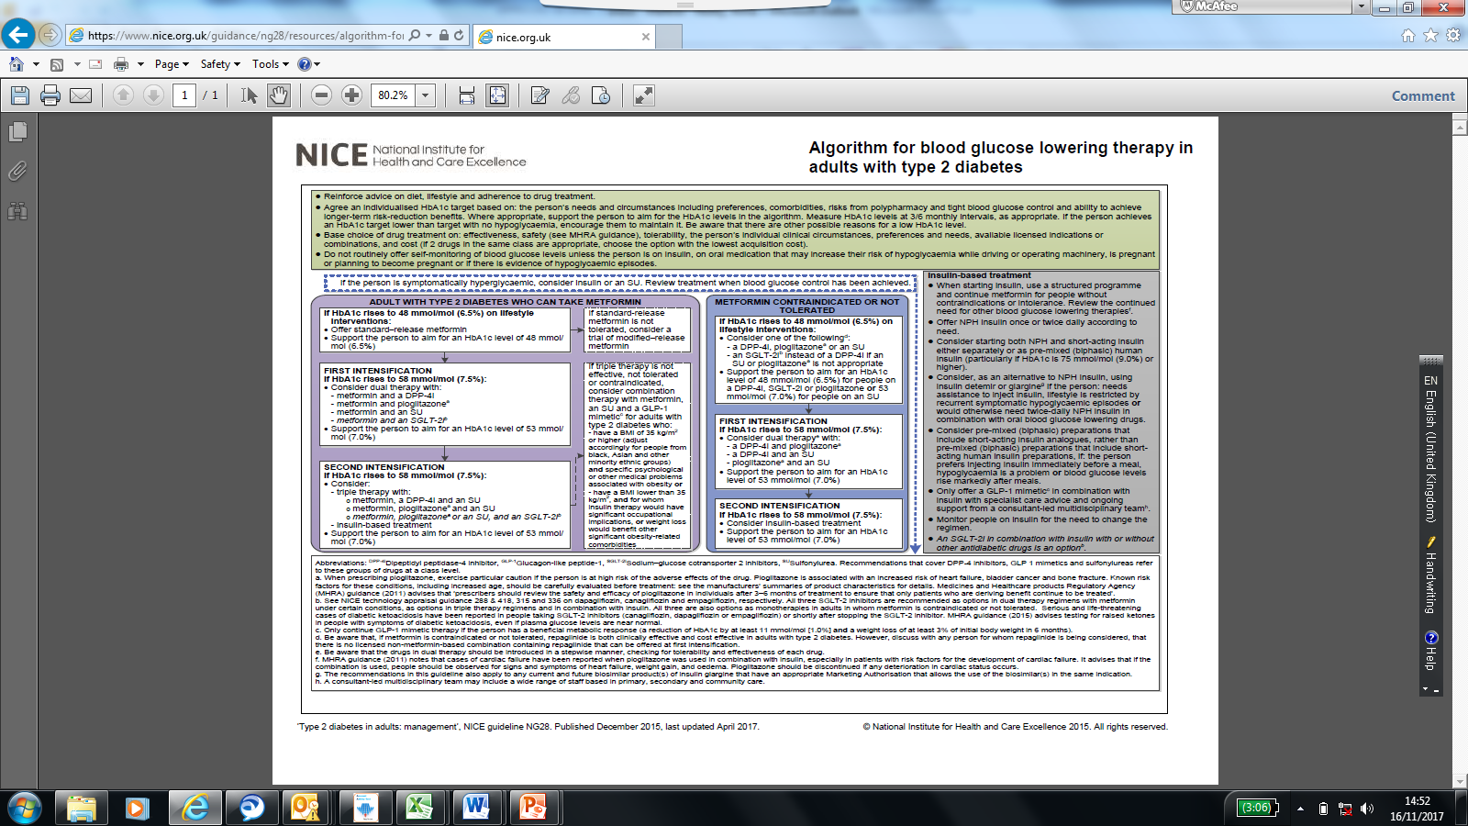

Slide 47
UKPDS found that metformin reduces risk of macrovascular complications
50
45
P=0.017
P=0.010
40
P=0.011
35
P=0.0023
P=0.02
30
% risk reduction
25
20
15
10
5
0
Any
Macrovascular
Myocardial
Diabetes
All cause
diabetes
infarction
related
mortality
related outcome
death
UKPDS 34. Lancet 1998;352:854–865

Slide 48

It is not about glucose ALONE
LIPIDS
BP
PLATELET FUNCTION
LIFE-STYLE

Slide 49

LIFESTYLE MODIFICATIONS

Slide 50
Low-Density Lipoprotein (LDL) Consists of Multiple Distinct Subclasses Differing in Size and Lipid Content*
Association with Cardiovascular Disease Risk
1
Large
Less Atherogenic
2
↓ clearance by LDL-R
↑ arterial entry
↑ arterial retention
↑ oxidation
3
Small
More Atherogenic
4
* Distribution of subclasses is
independent of LDL-C.
Berneis KK, Krauss RM. J Lipid Res. 2002;43:1363-1379.
Notes:
Low-density lipoprotein (LDL) consists of multiple distinct subclasses differing in size and lipid content
Low-density lipoproteins (LDLs) are known, however, to consist of a number of distinct subclasses, ranging from larger, more buoyant and lipid-enriched particles to smaller, more dense, and lipid-depleted particles. The smaller species have been associated more strongly with risk for cardiovascular disease. A number of properties of smaller LDLs may contribute to this risk, including reduced receptor-mediated clearance from plasma and, hence, greater exposure and entry into arterial tissue. In addition, smaller LDLs have been found to bind more avidly to arterial proteoglycans, leading to greater potential for retention in the artery when compared with larger LDLs. Finally, smaller LDLs are more susceptible to oxidation than are larger particles, and this property may lead to greater uptake by the arterial macrophages that form the foam cells of the arterial plaque.
Notably, the distribution of the major LDL subclasses differs widely among individuals, and this distribution is independent of LDL cholesterol.
Berneis KK, Krauss RM. Metabolic origins and clinical significance of LDL heterogeneity. J Lipid Res. 2002;43:1363-1379.

Slide 51
Adults With Diabetes Achieving
Vascular Disease Risk Factor Goals
NHANES III [1988–1994] (n=1204)
60
NHANES 1999–2000 (n=370)
50
48.2
44.3
40
37.0
35.8
33.9
29.0
30
Adults, %
20
10
5.2
7.3
0
A1C Level
<7%
Blood Pressure
<130/80 mmHg
Total Cholesterol
<200 mg/dL
Achieved All 3 Treatment Goals
Vascular Disease Risk Factors
Saydah SH et al. JAMA. 2004;291:335–342.
Notes:
Adults With Diabetes Achieving Vascular Disease Risk Factor Goals
Another review of data from NHANES III and data from NHANES 1999–2000 compared vascular disease risk factor goals among adults aged 20 years and older with previously diagnosed diabetes.¹
The goal of A1C <7%, as determined by the American Diabetes Association (ADA), decreased from 44.3% in NHANES III to 37% in NHANES 1999–2000.¹
Blood pressure <130/80 mmHg, as recommended by the ADA and Joint National Committee (JNC), increased from 29% to 35.8%.¹
Total cholesterol <200 mg/dL, as recommended by the National Cholesterol Education Program Adult Treatment Panel III (NCEP ATP III), increased from 33.9% to 48.2%.¹
Overall, the percentage of adults who achieved all 3 treatment goals was just 5.2% in NHANES III and 7.3% in NHANES 1999–2000.¹
This small improvement in goal achievement indicates that more public health efforts are needed to control risk factors among adults with diabetes.¹
Reference:
1. Saydah SH, Fradkin J, Cowie CC. Poor control of risk factors for vascular disease among adults with previously diagnosed diabetes. JAMA. 2004;291:335–342.
Saydah 2004
p. 338 A–C
p. 339 A–D
Saydah 2004
p. 336 D,E
p. 339 A
p. 341 A
p. 339 A
p. 339 A
p. 339 C-D

Slide 52
Which of the following statements best summarizes current treatment guidelines for type 2 diabetes mellitus (T2DM) relative to A1C targets?
A target of A1C < 48 is recommended, irrespective of age, duration of diabetes, or hypoglycemia risk
Target individualization over an A1C range is recommended, because not all patients benefit from intensive glycemic control
Recent CV outcomes trials suggest that A1C <48 is especially beneficial for patients with T2DM and CV disease

Slide 53
Hypoglycemia is a common and deleterious adverse effect of treatment for T2DM. Antihyperglycemic agents vary in their propensity to cause hypoglycemia
Of the drug classes listed below, which has the highest risk of causing hypoglycemia?
Biguanides (eg, metformin])
DPP 4 inhibitors
Sodium-glucose cotransporter-2 (SGLT-2) inhibitors
Sulfonylureas

Slide 54
In CV outcomes trials, which ones have been associated with an increased risk of hospitalization for heart failure.
Dipeptidyl peptidase-4 (DPP-4) inhibitor (eg,
alogliptin
linagliptin
saxagliptin,
sitagliptin

Slide 55
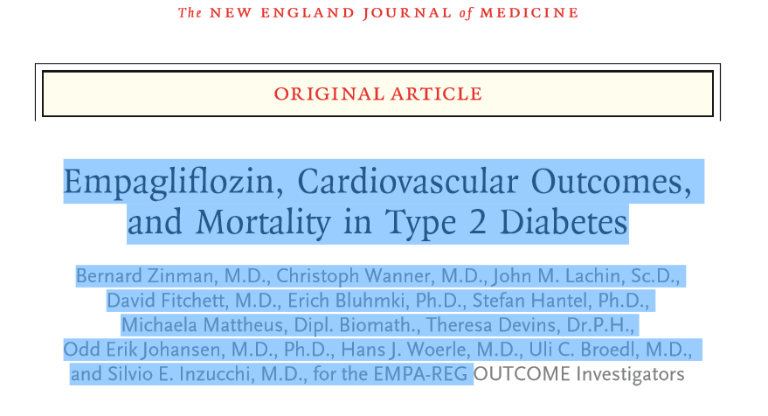

Slide 56
EMPA-REG OUTCOME®: Summary
Empagliflozin reduced hospitalisation for heart failure by 35%
Empagliflozin reduced CV death by 38%
Empagliflozin improved survival by reducing all-cause mortality by 32%

Slide 57
Number needed to treat (NNT) to prevent one death across landmark trials in patients with high CV risk
Ramipril²
for 5 years
  Simvastatin¹
  for 5.4 years
  Empagliflozin
  for 3 years
30
56
39
High CV risk
5% diabetes, 26% hypertension
High CV risk
38% diabetes, 46% hypertension
T2DM with high CV risk
92% hypertension
Pre-ACEi/ARB era
<29% statin
>80% ACEi/ARB
>75% statin
Pre-statin era
1994
2000
2015
Notes:
All cause death
Simva: 182 / 2221 (8,2%), placebo :256 / 2223 (11,5%) HR= 0,71[0,59;0,85]
pooled empa : 269 (5.7%)/2333, placebo : 194 (8.3%)/4687 HR= 0.68 (0.57,0.82)
Ramipril: 482 / 4645 (10,4%), placebo : 569 / 4652 (12,2%) HR=0,85[0,76;0,95]

Slide 64

TAKE HOME MESSAGES
TYPE 2 DIABETES IS UBIQUITOUS
THEY DIE OF HEART DISEASE
GLYCAEMIC TARGETS VARY
RISKS FROM HYPOGLYCAEMIA OUTWEIGHS BENEFITS FROM SUGAR CONTROL
DRUG CHOICES MATTER
HYPERTENSION AND LIPID CONTROL ARE AS IMPORTANT

Slide 65

  Thank you

Slide 68
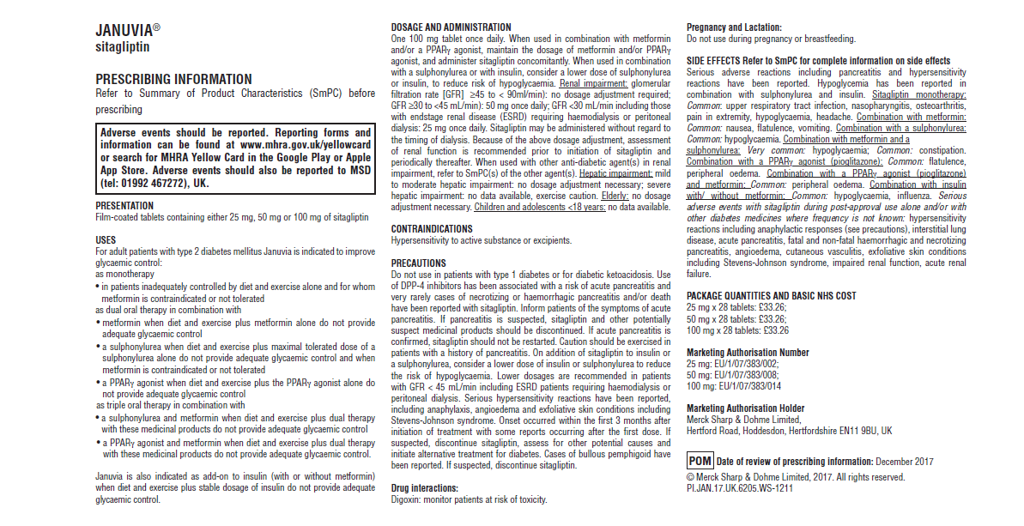
Prescribing information
DIAB-1244412-0000
Date of Preparation: January 2018

