Slide 1
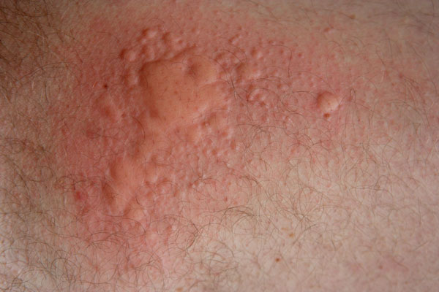
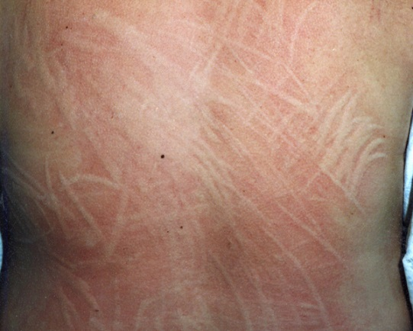
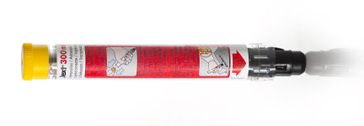
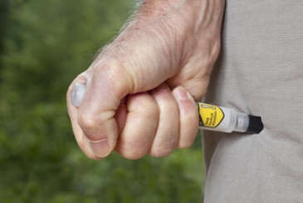
YHPA Immunology Symposium Anaphylaxis Urticaria & Angioedema
Vincent St Aubyn Crump FRCP
The Samlesbury Hotel
Saturday, 21st May 2016
Nothing to declare:
No conflict of Interest

Slide 2
Anaphylaxis
Vincent St Aubyn Crump FRCP
YHPA Immunology Symposium
21 May2016

Slide 3
The perplexing conundrum of anaphylaxis
Anaphylaxis is a perplexing disease,
It is under-recognized & undertreated
But
also many conditions masquerade & are misdiagnosed as anaphylaxis

Slide 4
Symptoms of Anaphylaxis
Skin (80-90%) – Itching, flushing, urticaria, angioedema
Eyes – Itching, tearing, redness, swelling of the skin around the eyes
Nose and mouth – Sneezing, runny nose, nasal congestion, swelling of the tongue, metallic taste
Lungs and throat (70%) – Difficulty getting air in or out, repeated coughing, chest tightness, wheezing or other sounds of labored breathing, increased mucus production, throat swelling or itching, hoarseness, change in voice, sensation of choking
Heart and circulation (70%) – Dizziness, weakness, fainting, rapid, slow, or irregular heart rate, low blood pressure
Digestive system – Nausea, vomiting, abdominal cramps, diarrhea
Nervous system – Anxiety, confusion, sense of impending doom

Slide 5
Common triggers for Anaphylaxis
Foods –
In children, hen's eggs, cow's milk, peanuts, tree nuts, fish, wheat, and soy are the most common food triggers.
In teens and adults, peanuts, tree nuts, fish, and crustaceans (shellfish such as shrimp) are the most common triggers
Any food, including fruits, vegetables, seeds, and some spices and food additives, can cause anaphylaxis.
Medications, such as antibiotics (penicillins and cephalosporins) and analgesics (aspirin, ibuprofen), potentially any medication.
Venom from insects, including bees, yellow jackets, wasps, hornets, and fire ants.
Latex from natural rubber, found in some latex gloves, balloons, condoms, sports equipment, and medical supplies.
Allergen immunotherapy ("allergy shots"), such as those given for the treatment of allergic rhinitis (hay fever).
Exercise, either by itself, or after food ingestion (eg, wheat, celery, shrimp, or other food) or after medication ingestion (eg, aspirin, ibuprofen).
Less common triggers include exposure to airborne allergens (such as horse dander), human seminal fluid, cold water, or cold air.

Slide 6
Case 1: ES 31 yr-old O+
Chronic spontaneous urticaria & angioedema for 10 years
Over last 6 months she has been getting more frequent & more severe attacks
1m before her referral she took Paracetamol 500mg x2 for a viral ilness and within ½ hour of first dose developed itching palms, generalised urticaria, angioedema of lips & tongue, difficulty breathing and tightness in throat ->A/E Rx adrenaline and discharged with adrenaline autoinjector
Medications:
Seretide inhaler
Fexofenadine 180mg prn for urticaria
Ibuprofen (OTC) prn for about 6m
PMH:
NSAIDs for dysmenorrhea and leading up to hospitalisation taking Ibuprofen more regularly for sprained ankle.
Moderate-severe asthma
Naprosyn-induced asthma 5 years ago
Skin Prick Test: Allergic to house dust mite
Oral Celecoxib /Celebrex (Selective NSAID) Challenge 2 weeks ago – passed: Celebrex 100mg po & observe for 2 hours
Advised to avoid ALL other (non-selective) NSAIDs & use Celebrex only
No need for EpiPen

Slide 7
Case 2: J Mc C 33 yr-old male
History:
June 2014 at 1am: Collapsed admitted to ICU on Cardiac monitor Discharge Diagnosis: Morbid Obesity & Type 2diabetes & advised to lose weight
2 episodes of anaphylaxis since life-style change:
28 June: within 30min brisk walking developed hives, diarrhoea, hospital (Systolic BP 50) Rx: adrenaline ,. Had pizza & alcohol
2nd 10 Aug: 1hr after subway -> gym collapsed after urticaria. “Unconscious for 10 min.” Rx: adrenaline
Current medication:
Metformin 500mg bd
Simvastatin
Past Medical History
Asthma: with colds
Eczema: as baby, no hay fever
DIET: eats wheat daily without any adverse effects
Family history : Unknown (adopted)
On Examination: Morbidly Obese

Slide 8
J Mc C: Investigations
Blood Test: ImmunoCAP RAST
Nut Mix 1 Class 2
Nut mix 1 contains :- Peanut, Hazelnut, Brazil nut, Almond and Coconut.
Nut mix 2: 0 Class
Nut mix 2 contains :- Pecan nut, Cashew nut, Pistachio and Walnut.
Wheat: 1 Class
Peanut: 0 Class
Silver Birch: 0 Class
Molecular wheat test
Omega-5-Gliadin: 3+ Class
Skin Prick Tests:
House dust mite: 0
Cat: 0mm
Dog: 0
Grass: 0
Birch: 0
Alternaria:0
Milk: 0
Egg: 0
Wheat: 3mm
Peanut: 0
Diagnosis?

Slide 9
Case 3: A rare case of anaphylaxis
28 yr-old pharmacist, married for 2 years & trying to start a family
Vaginal irritation for 18months. Worse after unprotected sex .
Fully investigated by Gynaecologist & Derm: no infections or contact dermatitis
Irritation getting worse & recently accompanied by hives all over body, on 2 occasions wheezing & light-headedness
PMH:
Atopic: Mild intermittent Asthma & perennial rhinitis
Atopic eczema as a child
Medications:
Salbutamol inhaler prn
Loratidine 10mg prn
Skin Prick Test:
House dust mite: 12mm
Grass: 0
Cat:7mm
Histamine: 4mm
Diagnosis: ?

Slide 10
Rare anaphylaxis continued
2 weeks later
Skin Prick Test
sample of husbands semen:12mm
Saline: 0
Histamine: 5mm
Specific IgE semen: class 3
Diagnosis: Semen Anaphylaxis

Slide 11
Case 4: MB,26 yr-old female
“Peanut anaphylaxis since age 13 yrs-old”
Over last 1 year anaphylaxis to increasing number of unrelated foods (soy, sesame, some unknown foods -reactions always occur after eating.
Reactions always while eating or within 1 hour
Sometimes hives, sometimes ‘bright red all over’/flushing,
throat closes up and she cant breathe-> Ambulance
About 10 visits to A/E in last 6m & used her EpiPen x3 times in last year & Flight emergency landing: peanut
Medications
EpiPen X 4
Seretide inhaler
Loratidine 10mg bd &Cetirizine 10mg nocte
Past Medical History
Asthma since age 5yrs
Atopic eczema as infant
Possible Chronic spontaneous urticaria
Social/ Family history
Works in bank, smokes 5cgs/dy
sister has asthma & Nut allergy
Diet: Meticulously reads labels and strictly avoids peanuts, nuts, seeds, egg, milk, most fruits, ….
Notes:
&

Slide 12
Investigations
Skin Prick Test
Specific IgE
House dust mite: 10mm
Grass: 10mm
Birch:12mm
Cat: 6mm
Milk: 0
Egg:0
Sesame: 0
Peanut: 0
Wheat: 4mm
Soy: 2mm
Peanut: 0
Ara h 2: 0
ALL tree nuts: negative
Milk:0
Egg: 0
Wheat: class 2 (o-5)
Previous investigations:
Had a blood test which said she was allergic to peanut, milk, egg, soy, wheat)
While skin testing
Diagnosis?

Slide 13
Diagnosis & Management
Not allergic to peanut
Laryngo-pharyngeal Reflux (Silent GERD) With Hyperventilation Syndrome /panic attacks
Improved with Omeprazole
Refused Oral blinded peanut Challenge
Refused referral for Psychological assessment

Slide 14
Prevalence of Anaphylaxis in UK
1 in 300 of the European population at some time in their lives suffer from anaphylaxis
20 people die from anaphylaxis each year in UK
The prevalence of anaphylaxis in the UK is increasing, but deaths from anaphylaxis is stable

Slide 15
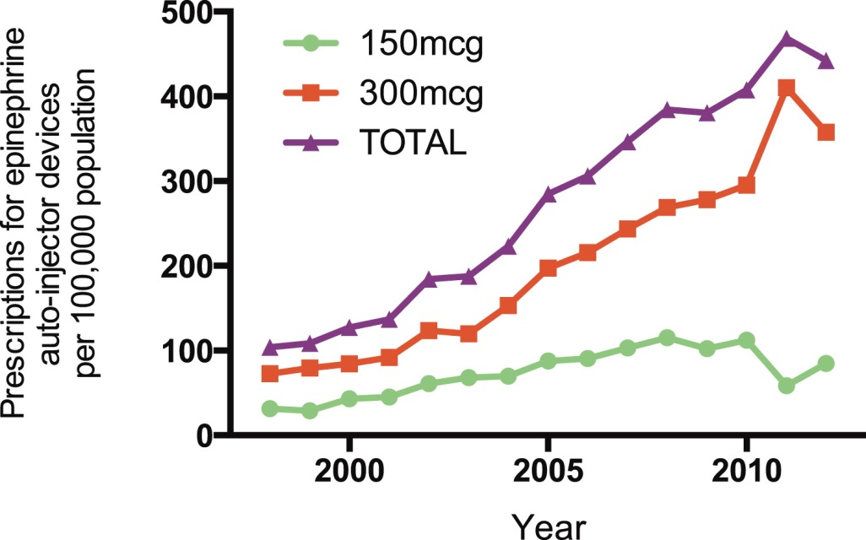
Increase in anaphylaxis-related hospitalizations but no increase in fatalities: An analysis of United Kingdom national anaphylaxis data, 1992-2012
Paul J. Turner & Richard Pumphrey et al, Jour Aller & Clin Immunol, 135 (4); 956-963 (April 2015)

Slide 16
Anaphylaxis admissions vs Anaphylactic fatalities

Slide 17
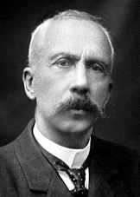
What is anaphylaxis?
First coined by French doctors, Charles Richet (Nobel winner) & Dr Portier in 1902 from Greek words ana meaning against & phylaxis (protection) Anaphylaxis = Anti-protection
Set of symptoms opposite of immunity that they were hoping to achieve by injecting sea anemone sting in a dog, which caused death due to anaphylaxis
Majority of anaphylaxis used to be caused by horse serum, penicillin & insect stings. Foods were rarely related before the last 3 decades

Slide 18
Symptoms of anaphylaxis
Skin – Itching, flushing, hives (urticaria), swelling (angioedema) 80-90%
Eyes – Itching, tearing, redness, swelling of the skin around the eyes
Nose and mouth – Sneezing, runny nose, nasal congestion, swelling of the tongue, metallic taste
Lungs and throat – Difficulty getting air in or out, repeated coughing, chest tightness, wheezing or other sounds of laboured breathing, increased mucus production, throat swelling or itching, hoarseness, change in voice, sensation of choking : 70%
Heart and circulation – Dizziness, weakness, fainting, rapid, slow, or irregular heart rate, low blood pressure 70%
Digestive system – Nausea, vomiting, abdominal cramps, diarrhoea
Nervous system – Anxiety, confusion, sense of impending doom

Slide 19
Definition of anaphylaxis vs systemic allergic reactions
Anaphylaxis is a severe, life-threatening generalised or systemic hypersensitivity reaction which is likely when both of the following criteria are met:
1. Sudden onset and rapid progression of symptoms
2. Life-threatening airway and/or breathing and/or circulation problems
Skin and/or mucosal changes (flushing, urticaria, angioedema) often also occur but are absent in a significant proportion of cases.
Gastro-intestinal symptoms (vomiting, diarrhoea, abdominal pain) can also be associated with symptoms of anaphylaxis.
Skin / mucosal and gastrointestinal symptoms without airway, breathing or circulation symptoms are systemic allergic reactions, but not life threatening reactions and therefore not classified as anaphylaxis.

Slide 20
3 Clinical criteria for diagnosing anaphylaxis (WAO)
Anaphylaxis is highly likely when any 1 of the following 3 criteria are fulfilled:
Acute onset of an illness (minutes to hours) Involvement of skin, mucosal tissue, or both (i.e., generalised hives, pruritus, or flushing, swollen lips-tongue-uvula) and at least 1 of the following:
Respiratory compromise (i.e., dyspnoea, wheeze-bronchospasm, stridor, reduced peak expiratory flow [PEF], hypoxaemia) or
Reduced BP or associated symptoms of end-organ dysfunction (i.e., hypotonia/collapse, syncope, incontinence)
Occurrence of 2 or more of the following symptoms or signs after exposure to a likely allergen (minutes or hours)
Involvement of skin, mucosal tissue, or both (i.e., generalised hives, pruritus, or flushing, swollen lips-tongue-uvula)
Respiratory compromise (i.e., dyspnoea, wheeze-bronchospasm, stridor, reduced PEF, hypoxaemia)
Reduced BP or associated symptoms of end-organ dysfunction (i.e., hypotonia/collapse, syncope, incontinence)
Persistent GI symptoms (i.e., crampy abdominal pain, vomiting)
Reduced BP after exposure to a known allergen (minutes to several hours)
Systolic BP of <90 mmHg or >30% decrease from baseline.

Slide 21
Classification of Anaphylaxis
Anaphylaxis
Immunologic
IgE-mediated
Non-IgE mediated
IgG
Non-immunologic
Drugs
Physical
Exercise
Cold
Idiopathic

Slide 22
Anaphylactic deaths in UK
Fatal Anaphylaxis in UK 1992 – 2001.
Pumphrey R Curr Opin All Clin Immunol 4 (4): 285-290, 2004
~20 deaths per year

Slide 23
Suspected causes of anaphylactic deaths in UK
Non-food:139
Foods: 45 (+?18)
Drugs: 88
Anaesthetics: 35
Suxamethonium: 19…
Antibiotics: 27
Cephalosporin: 12
Aminopenicillin: 10
Other drugs: 15
NSAID: 6
Gelatines: 5
ACE inhibitor: 3
Vitamin K: 2
Contrast Media: 11
Iodinated: 9
Stings: 47
29 wasp
4 bee
14 unidentified
Other:
latex: 1
hair dye: 1
idiopathic:1
Nuts: 32
Peanut: 10
Walnut: 6
Almond: 2
Brazil nut: 2
Mixed or unidentified: 11
Other Foods: 13
Milk: 5
Fish: 2
Crustacean: 2
Chickpea: 2
Banana: 1
Snail: 1
?Food: 18
During meal: 5
?milk: 3
? nuts: 3
?Grape: 1
?Fish: 1
? Nectarine: 1

Slide 24
Anaphylactic deaths: First-Time Reactions
Although most patients had been stung or exposed to the causative drug previously without a reaction, fatal reactions was thought to be the first in:
23/34 sting
17/24 antibiotics
17/20 muscle relaxants
4/6 NSAID
13/13 other drug
10/10 contrast media

Slide 25
Risk factors for anaphylactic reactions (co-factors)
Augmenting factors
Factors which lower the reaction threshold or which make symptoms more severe by directly influencing the immunological mechanism of type 1 allergy:
Exercise
NASID
Antacid / PPI
Alcohol
Infections
Menstruation
Co-factors
= a subgroup of risk factors, not acting on an immunological basis themselves
eg.
Certain allergens (nuts)
Adolescence
ACE-inhibitors
Beta-blockers
Psyche
Concomitant diseases
= Co-existing diseases, which jeoparadize patients or which increase mortality
e.g.
Asthma
Cardiac disease
Mastocytosis

Slide 26
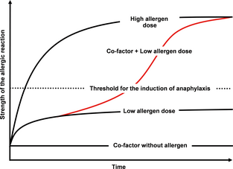
Threshold dose & co-factor-dependent anaphylaxis
Up to 39% of severe anaphylactic reactions are triggered by cofactors

Slide 27
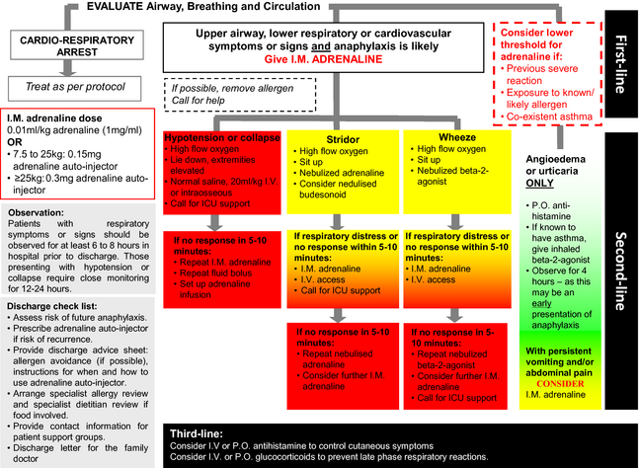
Management of Anaphylaxis

Slide 28
Management of Anaphylaxis in community: Post-emergency
After emergency treatment for a suspected anaphylactic reaction
Children <16 year-old:
Admission
Adults >16 year-old:
Observation for 6-12 hrs from onset of symptoms
NICE pathway for Drug Allergy
NICE pathway for Food Allergy
NICE patway for pt. experience
Mast Cell Tryptase
As soon as possible after emergency RX and the second 1-2 hours (no later than 4 hrs) after
er
Adrenaline Autoinjector & Patient Info & Support before discharge
Specialist Allergy Service
Refer

